Slide 1
Metallic Bonding
Year 10 PreATAR Science

Slide 2
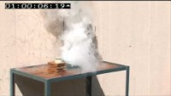

Slide 3
Review
What is the common name of
Group I
Group 2
Group 17
Group 18
2. Which group would zinc and iron be in?
3. The number of electron shells determines which group/period an element is in.
4. The number of electrons in the outer shell determines which group/period an element is in.

Slide 4
Review
5. Draw an atom of carbon-12 showing all of its protons, neutrons and electrons (in shells)
6. When alkali metals react with water, which flammable gas is produced?
7. If potassium is so reactive, why are bananas not explosive?

Slide 5
Learning Intentions
the physical properties of metals, such as melting and boiling point, density, malleability and ductility, lustre and conductivity
the bonding arrangement of atoms and their electrons in metals
use the bonding arrangement to explain properties

Slide 6
Success criteria
List the properties of metals
Draw a diagram to represent bonding of metals
Explain how bonding arrangement relates to each property

Slide 7
Key words
valence
metallic
lattice
delocalised
malleable
ductile

Slide 8
Bonding
The type of bonding that forms between atoms is determined by their valence
Valence is the how ‘full’ the outer electron shell is
The more electrons in an outer shell, the more strongly the electrons are held.
The three main types of bonding that occur between atoms are metallic, ionic and covalent.

Slide 9
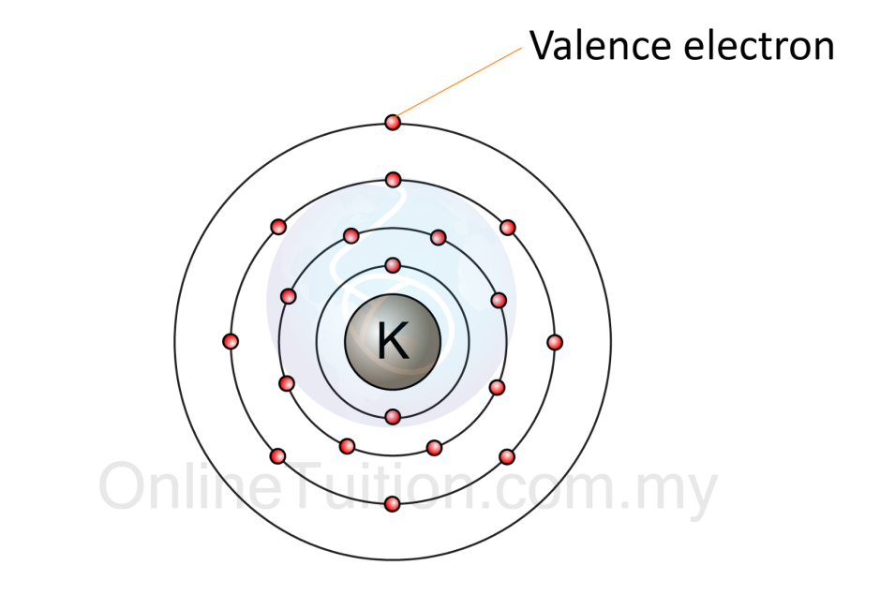
Metal valence
Metals have low valence – their outer shells are relatively empty and their outer electrons are weakly held.

Slide 10
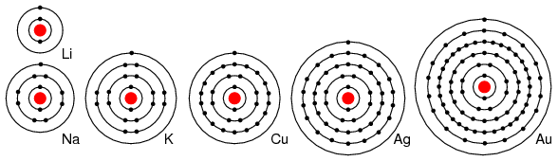

Slide 11
metallic bonding
Metal atoms are densely packed together, usually in a neat 3D arrangement
The outer shell electrons tend to be equally attracted to any atom – they are ‘delocalised’ and can move easily within the lattice of atoms

Slide 12
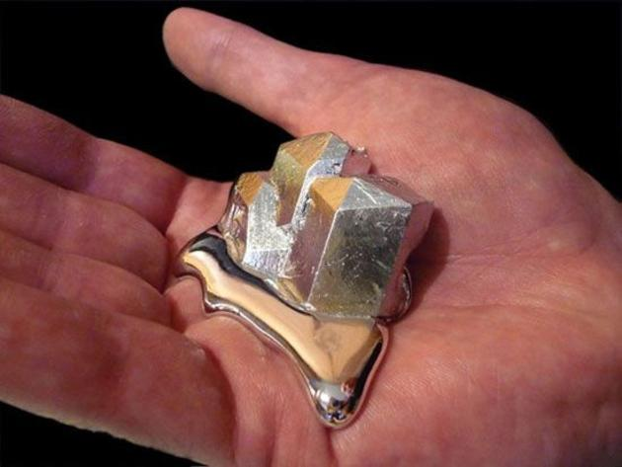
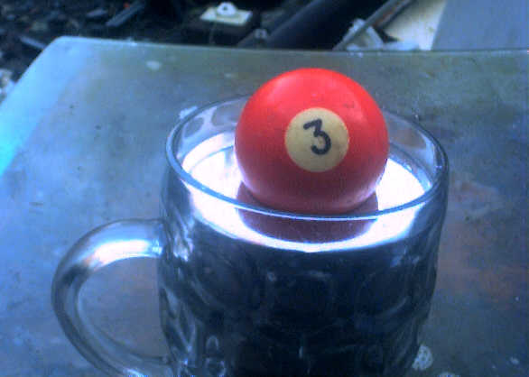
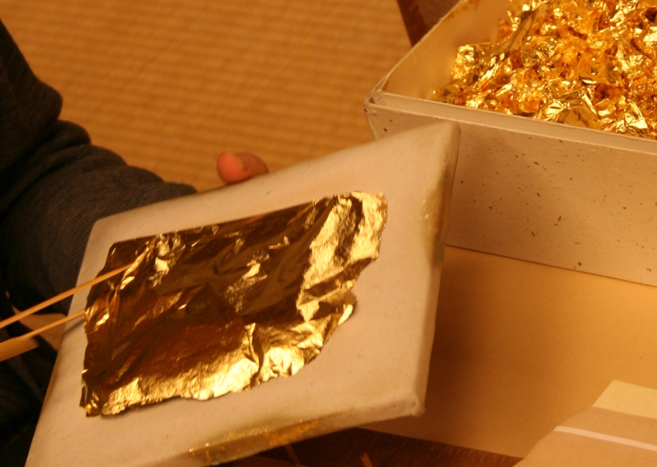
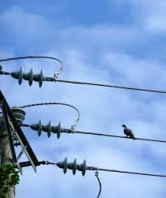
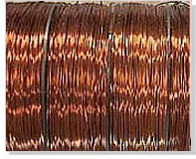
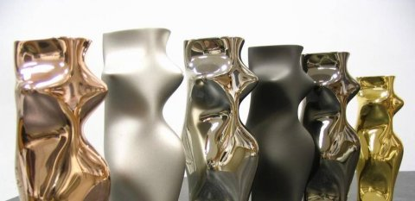
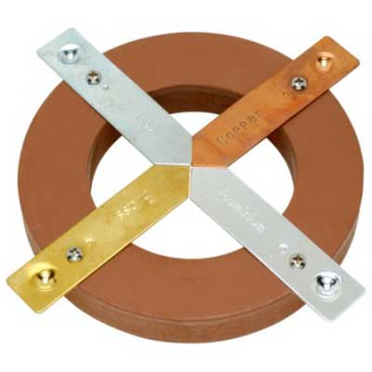
properties of metals
Moderate melting and boiling point (usually solid at room temperature)
Dense
Good thermal conductors
Good electrical conductors
Lustrous (shiny)
Malleable
Ductile

Slide 13
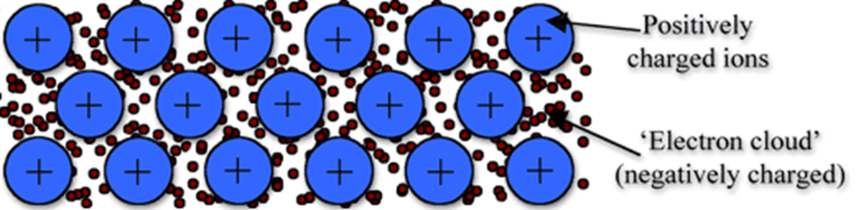
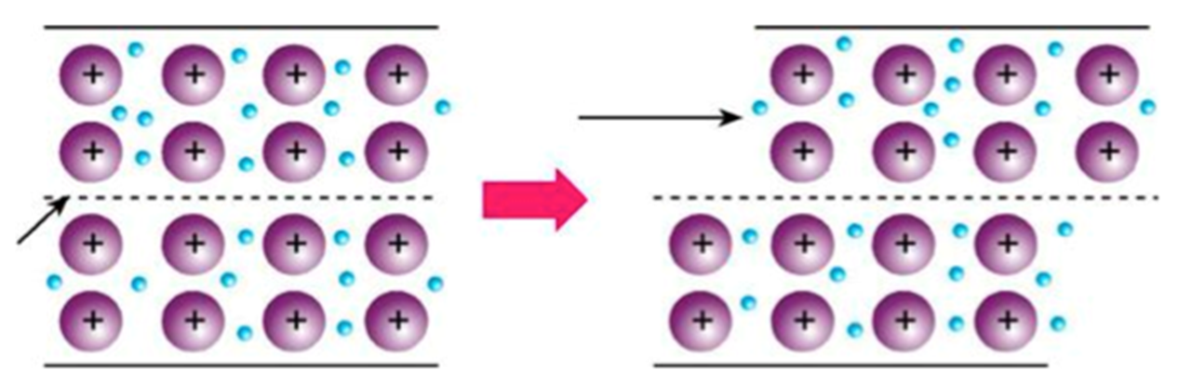
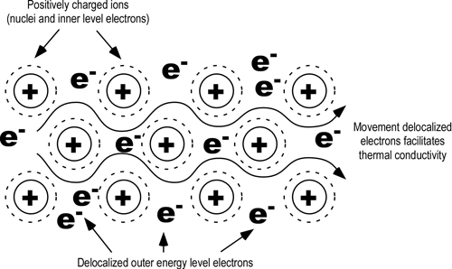

Slide 14
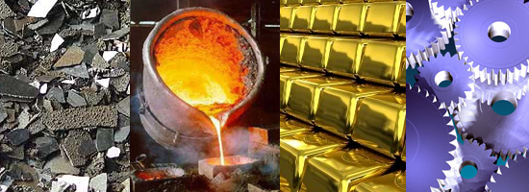

Slide 15
Success criteria
List the properties of metals
Draw a diagram to represent bonding of metals
Explain how bonding arrangement relates to each property

